Slide 1
Colors
Black
PMS Pantone Black
CMYK 0-0-0-100
RGB 0-0-0
HEX #000000
Aqua
PMS 7474 CP
CMYK 96-9-32-29
RGB 0-123-140
HEX #007B8C
Red
PMS 186
CMYK 0-100-81-4
RGB 204-9-47
HEX #CC092F
Dark Gray
PMS Cool Gray 11
CMYK 0-0-0-80
RGB 83-86-90
HEX #53565A
White
CMYK 0-0-0-0
RGB 255-255-255
HEX #FFFFFF
Purple
PMS 7678 C
CMYK 74-85-0-0
RGB 108-75-148
HEX #6C4B94
Orange
PMS 138 CP
CMYK 0-52-100-0
RGB 230-140-40
HEX #E68C28
Cool Gray 7
PMS Cool Gray 7
CMYK 0-0-0-48
RGB 151-153-155
HEX #97999B
Dark Blue
PMS 4146
CMYK 100-82-0-81
RGB 27-29-54
HEX #1B1D36
Azure
PMS 313 CP
CMYK 100-0-11-2
RGB 0-152-199
HEX #0098C7
(AA Compliant)
RGB 0-125-163
HEX #007DA3
Yellow
PMS 7408 CP
CMYK 0-29-100-0
RGB 243-186-22
HEX #F3BA16
Broadcom Gray
CMYK 0-0-0-12
RGB 226-227-228
HEX #E2E3E4
Blue
PMS 7469 C CMYK 96-64-24-6 RGB 0-92-138 HEX #005C8A
Green
PMS 369 C
CMYK 67-12-100-1
RGB 97-166-14
HEX #61A60E
(AA Compliant)
RGB 35-128-10
HEX #23800A

Slide 2
VCF Low Level Design Diagrams
VCF Operations for networks

Slide 3
VCF Constructs v1
VCF Private Cloud
VCF Fleet
VCF Fleet
VCF Operations
VCF Operations
VCF Automation
VCF Automation
VCF Instance
VCF Instance
Management Domain
Management Domain
vCenter
vCenter
NSX
NSX
SDDC Manager
SDDC Manager
Workload Domains
Workload Domains
Additional VCF Instances
Additional VCF Instances

Slide 4
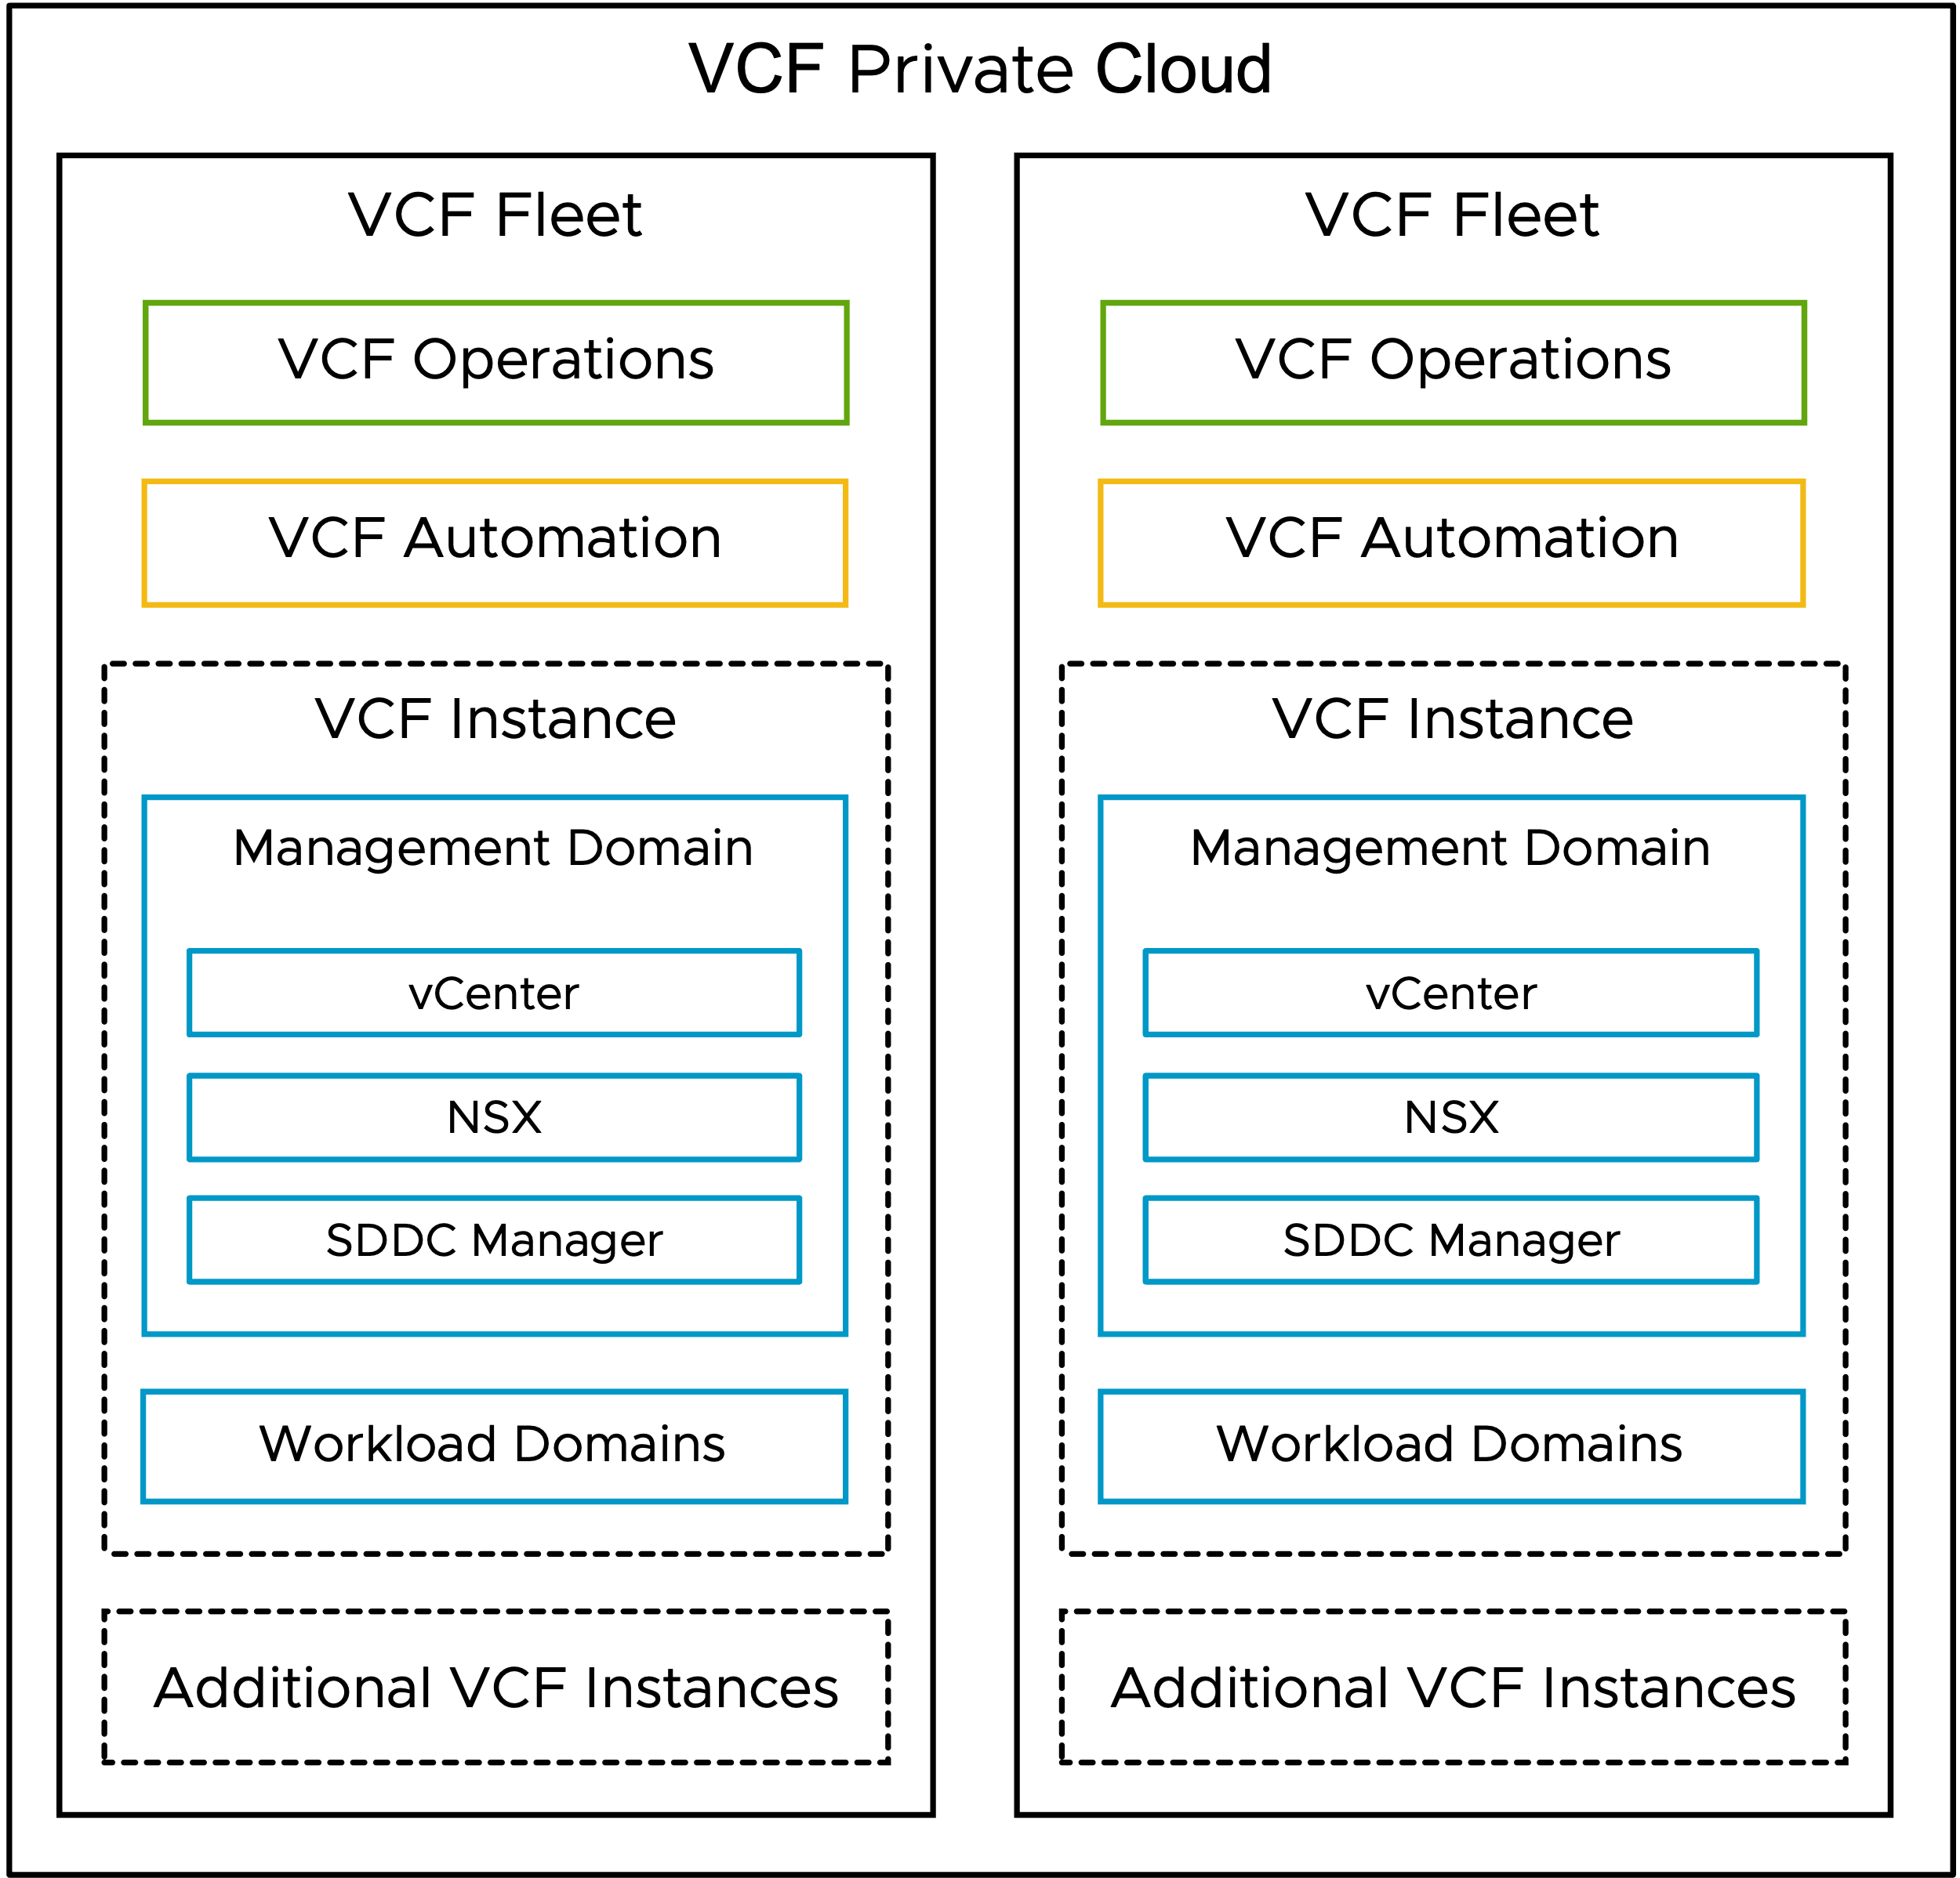
VCF Constructs v1 (SVG Image)

Slide 5
VCF Operations Models

Slide 6
VCF Operations Models v1
Simple - VCF Operations
High Availability - VCF Operations
VCF Operations
VCF Instance Account
VCF Operations
VCF Operations
(Fleet Management)
Management Domain
VCF Operations
(Fleet Management)
VCF Operations
Primary node
vCenter Adapter
VCF Operations
Primary node
vSAN Adapter
VCF Instance Account
NSX Adapter
Management Domain
VCF Operations
Replica node
vCenter Adapter
Workload Domain
VCF Operations
Data node
vSAN Adapter
vCenter Adapter
NSX Adapter
VCF Operations Collectors
vSAN Adapter
VCF Operations
Collector node
NSX Adapter
Workload Domain
vCenter Adapter
VCF Operations Collectors
vSAN Adapter
VCF Operations
Collector node
NSX Adapter

Slide 7
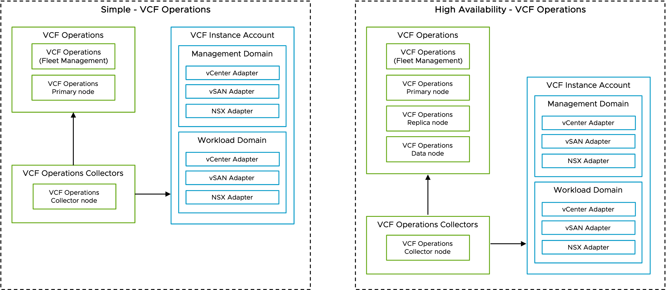
VCF Operations Models v1 (SVG Image)

Slide 8
VCF Operations for Networks Models

Slide 9
VCF Operations for Networks Models v1
Simple - VCF Operations for Networks
High Availability - VCF Operations for Networks
VCF Operations
VCF Operations
VCF Operations
VCF Operations
(Fleet Management)
VCF Operations
Collector node
VCF Operations
VCF Operations
(Fleet Management)
VCF Operations
Collector node
VCF Operations for Networks
VCF Operations for Networks
VCF Operations for Networks
Platform Node
VCF Operations for Networks
Collector Node
Cluster
VCF Operations for Networks
Platform Node
VCF Operations for Networks
Platform Node
VCF Operations for Networks
Platform Node
VCF Instance
VCF Operations for Networks
Collector Node
Management Domain
Workload Domain
vCenter
vCenter
NSX Manager
NSX Manager
VCF Instance
SDDC Manager
Management Domain
Workload Domain
vCenter
vCenter
NSX Manager
NSX Manager
SDDC Manager

Slide 10
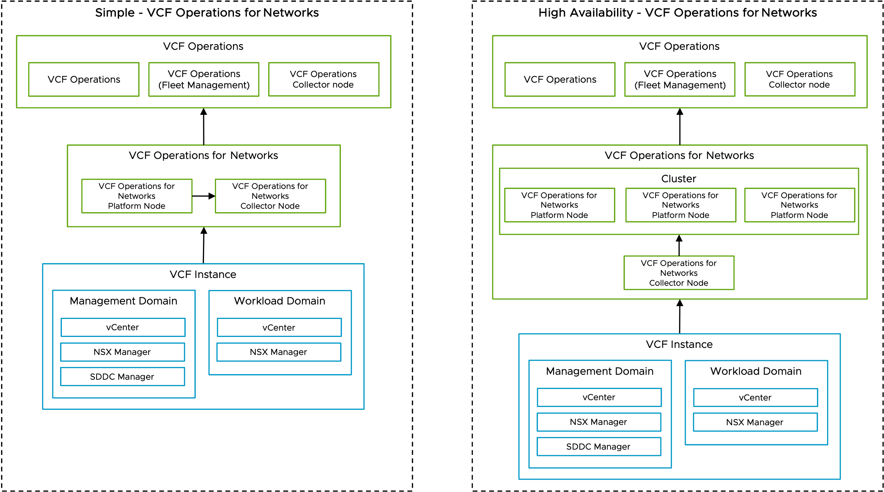
VCF Operations for Networks v1 (SVG Image)

